Slide 1
Network Admins Hate Him!
Local noob bypasses firewall with ONE WEIRD TRICK

Slide 2
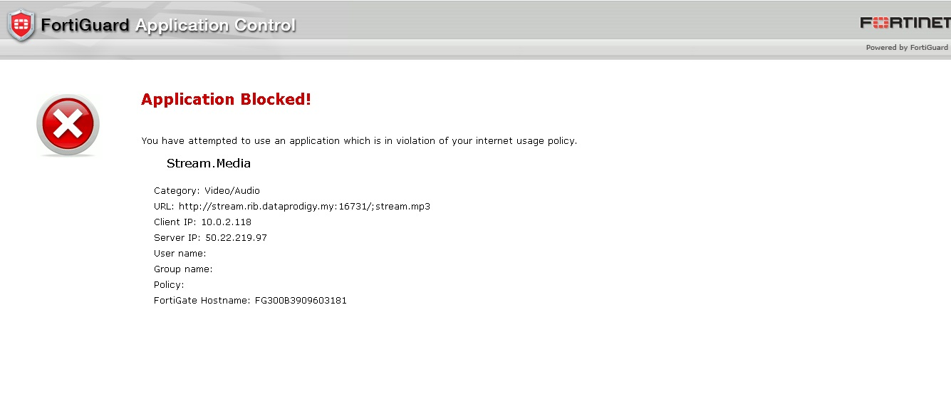

Slide 3

Agenda
Easy bypass tricks
Proxies and VPNs
SSH Tunnels
Alternative protocols
DPI Evasion
Domain Fronting

Slide 4
Easy Bypass Tricks

Slide 5
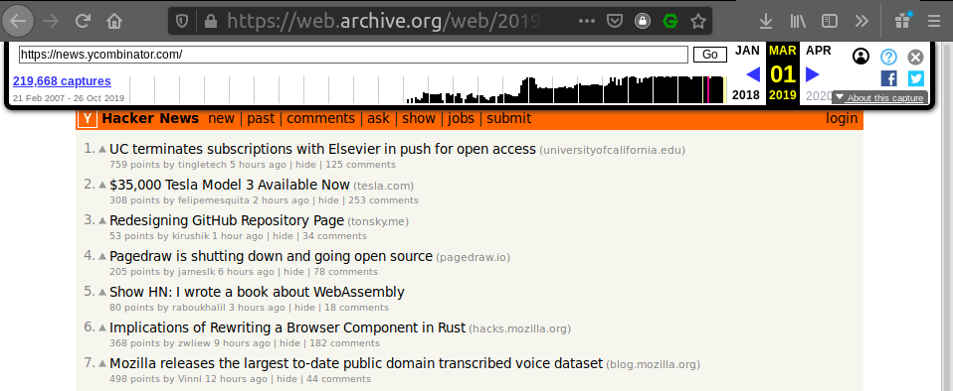
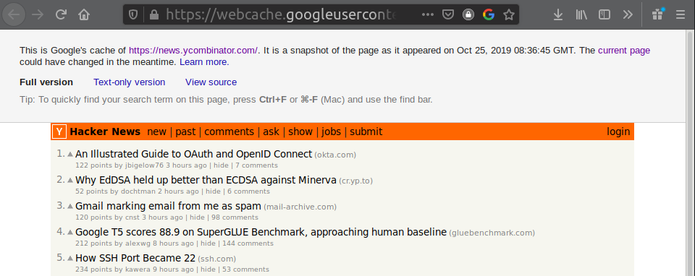
Using Web Caches
https://webcache.googleusercontent.com/search?q=cache:http://news.ycombinator.com
https://web.archive.org/web/20190301001958/https://news.ycombinator.com/

Slide 6
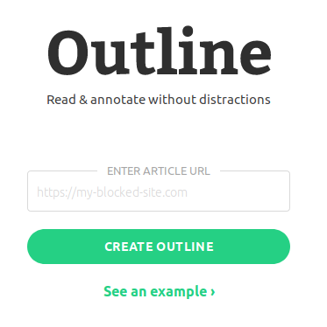
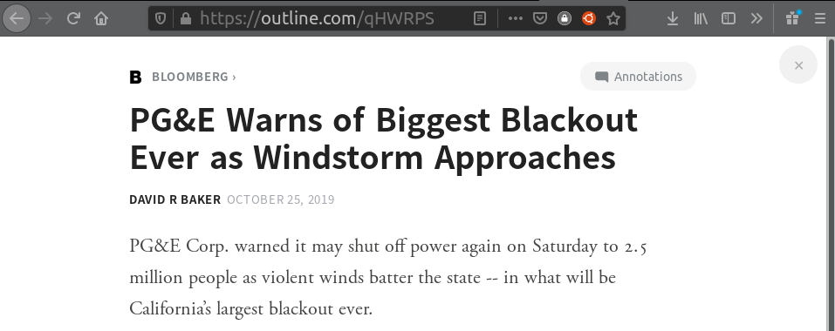
Bypass paywalls for news sites
https://outline.com/https://www.bloomberg.com/news/articles/2019-10-25/pg-e-warns-of-biggest-blackout-ever-as-windstorm-approaches?srnd=premium

Slide 7


Bypass paywalls for news sites
https://outline.com/https://www.ft.com/content/30fc84da-f781-11e9-a79c-bc9acae3b654

Slide 8
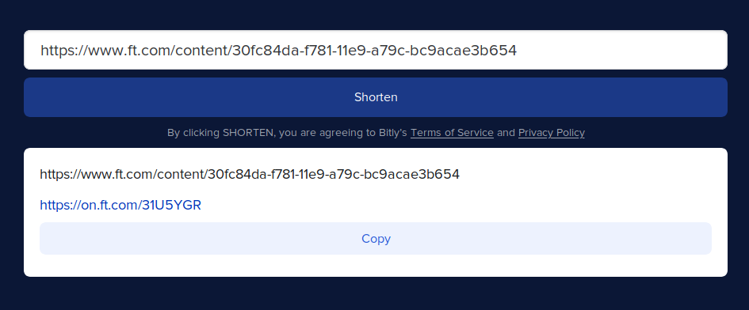
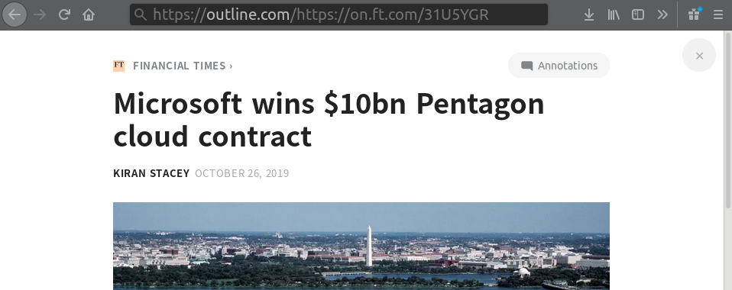
Bypass paywalls for news sites
https://outline.com/https://on.ft.com/31U5YGR

Slide 9
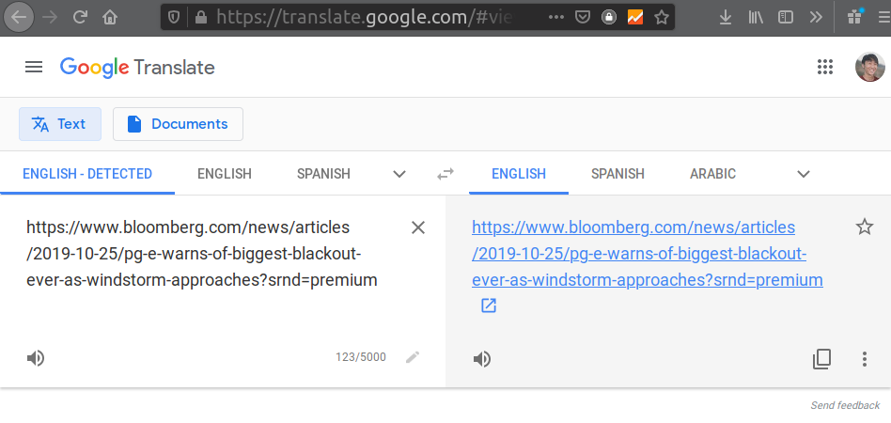

Using Google Translate
https://translate.google.com/translate?hl=&sl=auto&tl=vi&u=https%3A%2F%2Fwww.bloomberg.com%2Fnews%2Farticles%2F2019-10-25%2Fpg-e-warns-of-biggest-blackout-ever-as-windstorm-approaches%3Fsrnd%3Dpremium

Slide 10
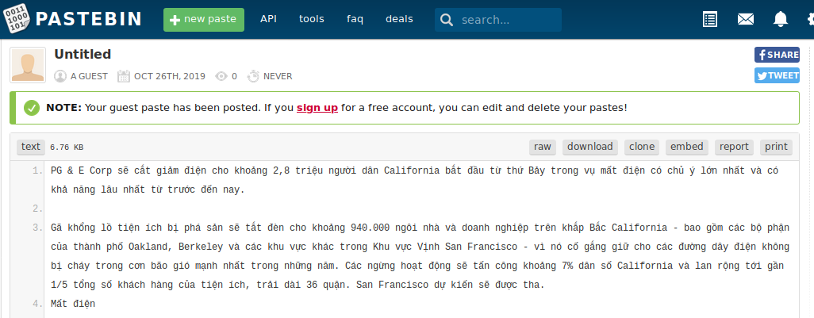
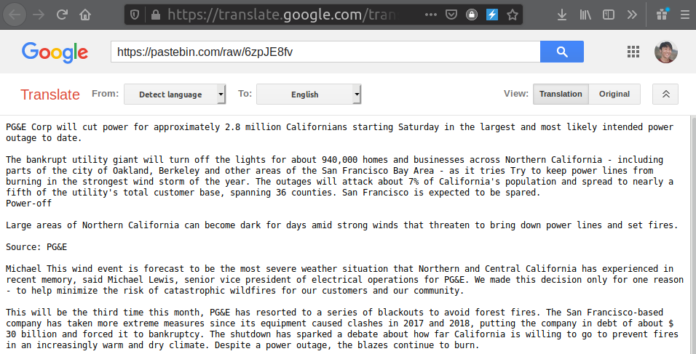
Translate the Translation
https://translate.google.com/translate?sl=auto&tl=en&u=https%3A%2F%2Fpastebin.com%2Fraw%2F6zpJE8fv

Slide 11
German
Dutch
Norwegian
Spanish
English

Slide 12
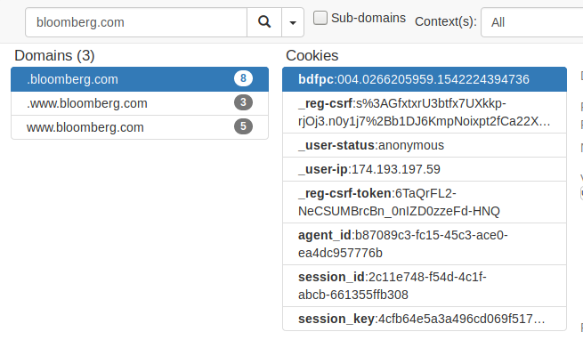
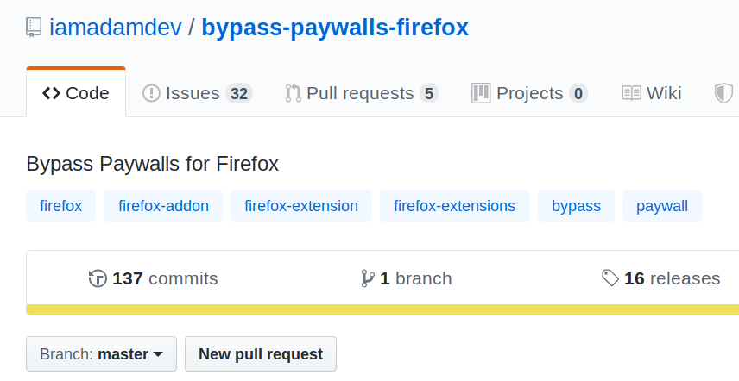
Bypass paywalls for news sites

Slide 13
Proxies & VPNs

Slide 14


Slide 15
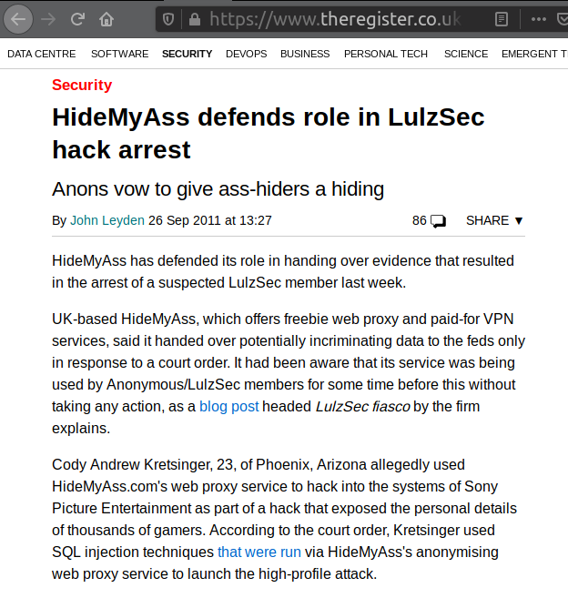

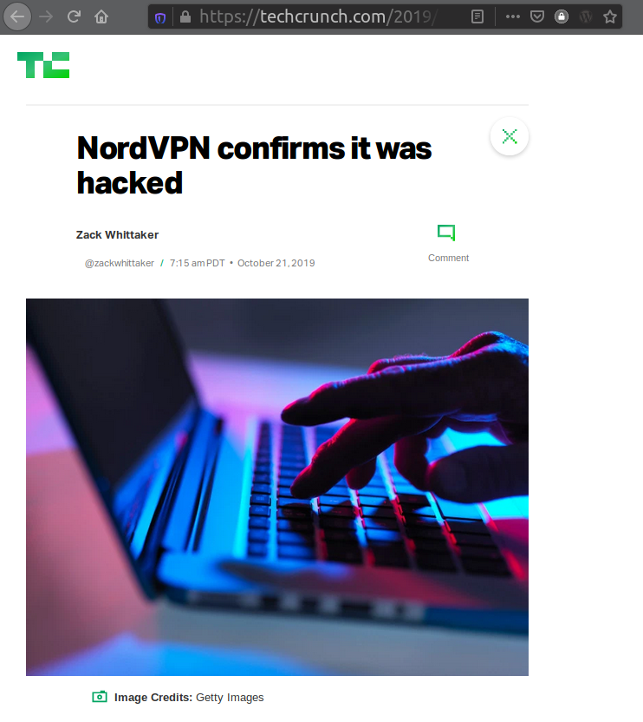
Don’t use them*
Roll your own.
It’s easier than you think.

Slide 16
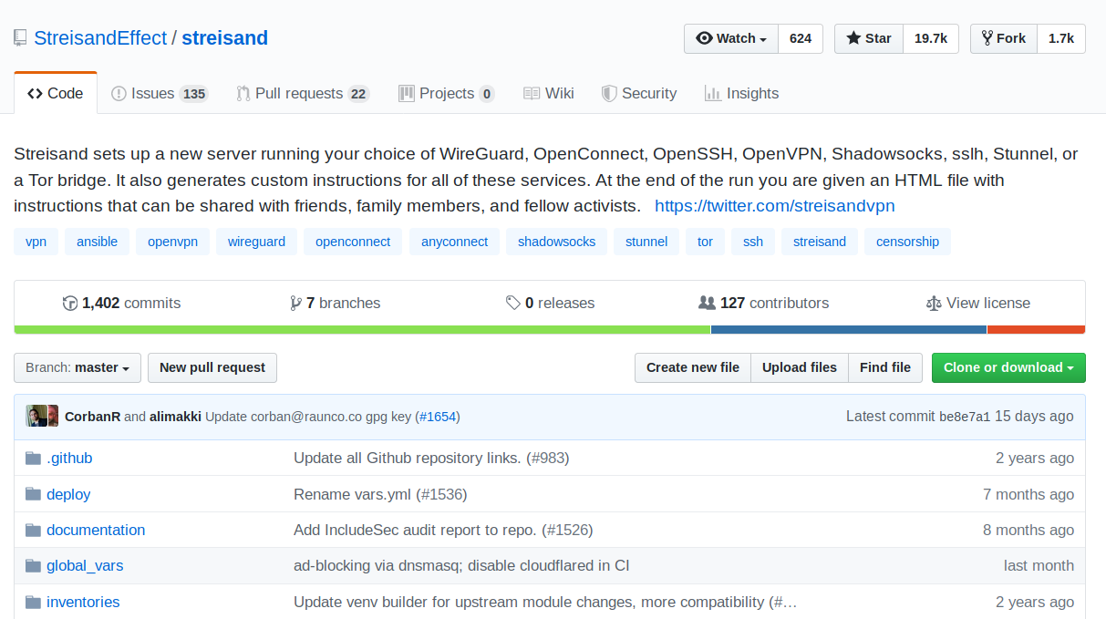

Slide 17






Slide 18
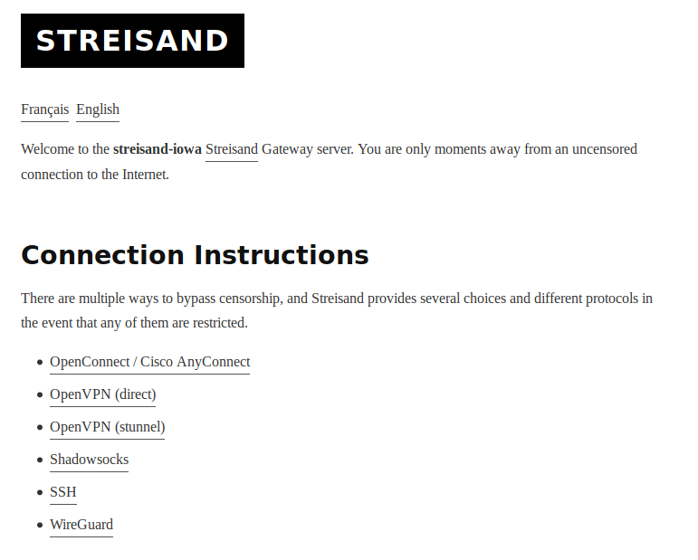

Slide 19
Use High Reputation Domains & IPs

Slide 20
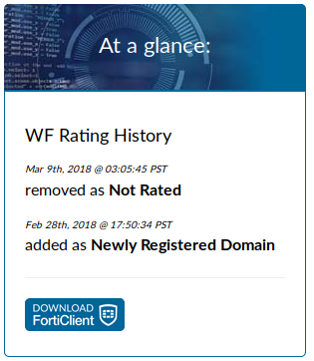
k@X1 ~ » curl ip-ranges.amazonaws.com/ip-ranges.json
{
"syncToken": "1571956989",
"createDate": "2019-10-24-22-43-09",
"prefixes": [
{
"ip_prefix": "13.248.118.0/24",
"region": "eu-west-1",
"service": "AMAZON"
},
{
"ip_prefix": "18.208.0.0/13",
"region": "us-east-1",
"service": "AMAZON"
},
{
"ip_prefix": "52.95.245.0/24",
"region": "us-east-1",
"service": "AMAZON"
},
{
k@X1 ~ $ curl ipinfo.io/13.248.118.4
{
"ip": "13.248.118.4",
"city": "Dublin",
"region": "Leinster",
"country": "IE",
"loc": "53.3331,-6.2489",
"postal": "D02",
"timezone": "Europe/Dublin"
}%

Slide 21
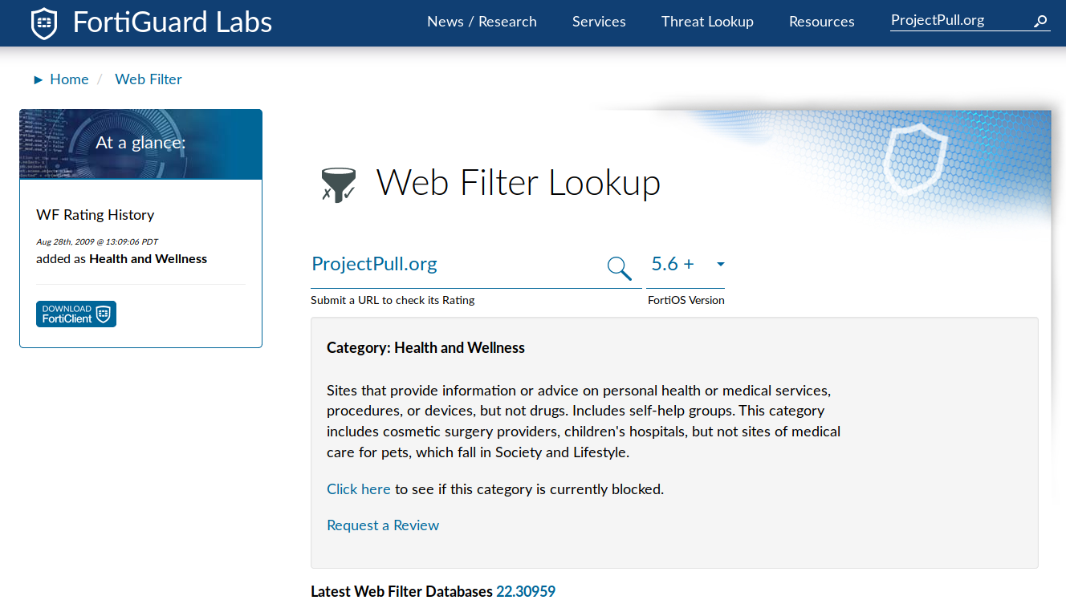
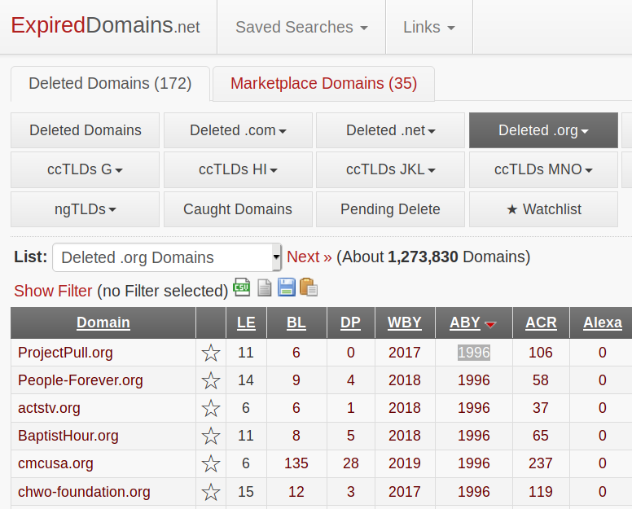

Slide 22
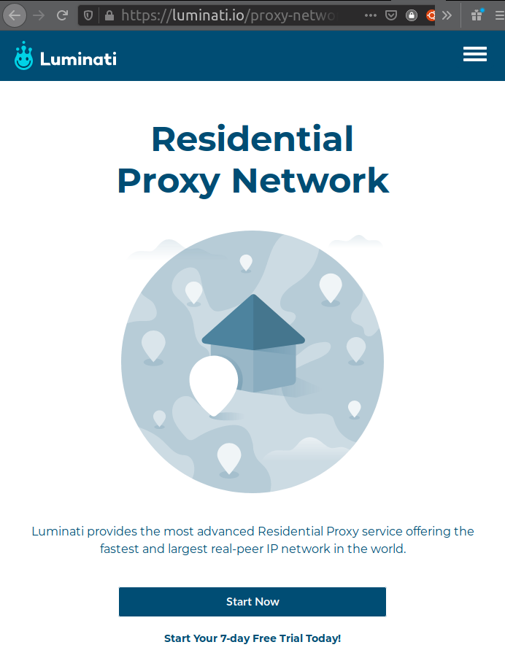
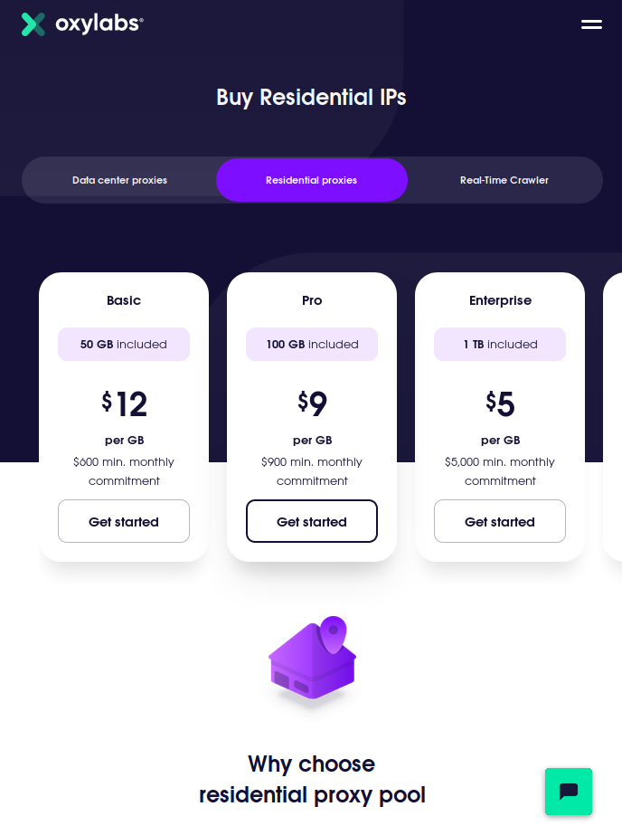

Slide 23
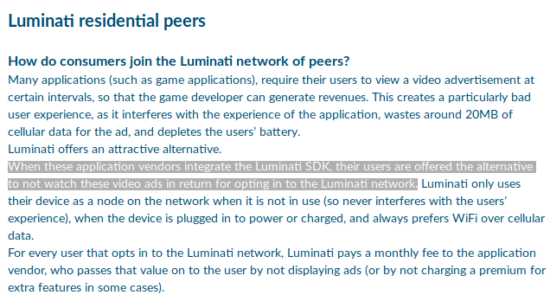

Slide 24
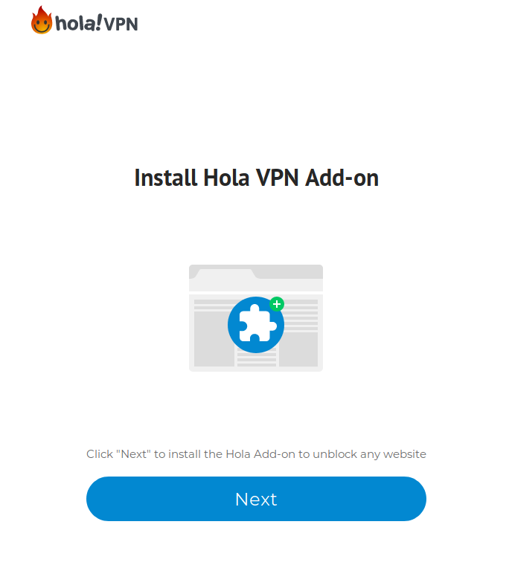
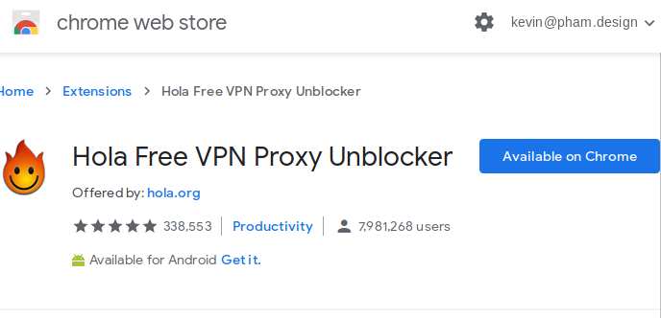
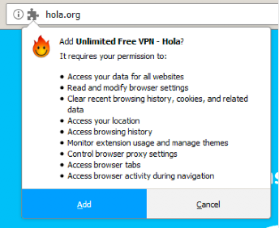
join our botnet

Slide 25
SSH Tunneling

Slide 26
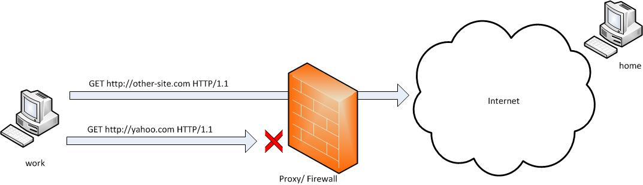

Slide 27
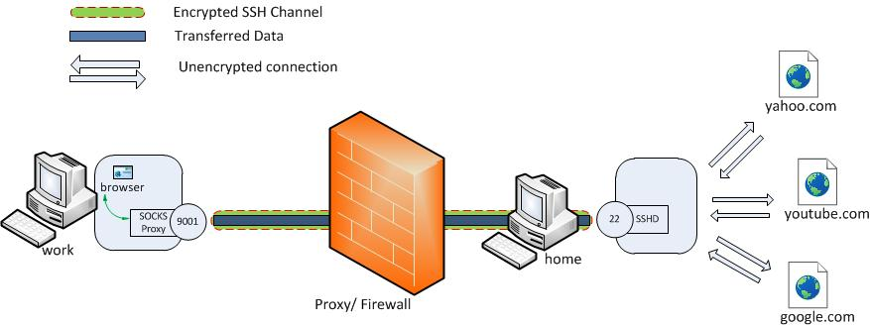
ssh -D 9001 projectpull.org
projectpull.org

Slide 28
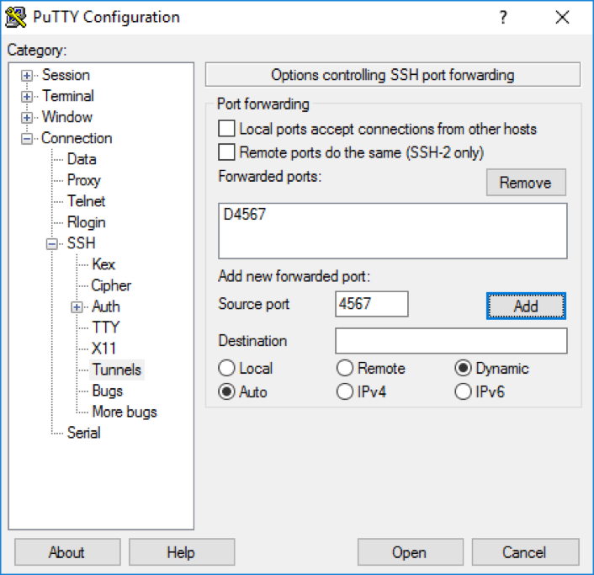
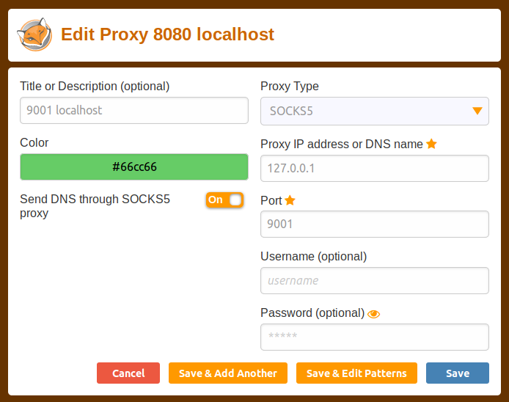
D9001
9001
Protip: Use SSH software that’s already installed + browser extension
No local admin needed!

Slide 29
Protip: Use SSH config files
k@X1 ~ $ cat ~/.ssh/config
Host streissand
User forward
Port 443
HostName projectpull.org
IdentityFile ~/.ssh/id_rsa
DynamicForward 9001
k@X1 ~ $ ssh streissand
OpenSSH_7.6p1 Ubuntu-4ubuntu0.3, OpenSSL 1.0.2n 7 Dec 2017
debug1: Reading configuration data /home/k/.ssh/config
debug1: /home/k/.ssh/config line 18: Applying options for streisand-iowa-gcp-forward-443
debug1: Reading configuration data /etc/ssh/ssh_config
debug1: /etc/ssh/ssh_config line 19: Applying options for *
debug1: Connecting to 104.198.220.37 [104.198.220.37] port 443.
debug1: Connection established.

Slide 30
Protip: Use proxychains for specific commands only
k@X1 ~ $ proxychains curl ipinfo.io
ProxyChains-3.1 (http://proxychains.sf.net)
|DNS-request| ipinfo.io
|S-chain|-<>-127.0.0.1:8080-<><>-4.2.2.2:53-<><>-OK
|DNS-response| ipinfo.io is 216.239.34.21
|S-chain|-<>-127.0.0.1:8080-<><>-216.239.34.21:80-<><>-OK
{
"ip": "104.198.220.37",
"hostname": "37.220.198.104.bc.googleusercontent.com",
"city": "New York City",
"region": "New York",
"country": "US",
"loc": "40.7143,-74.0060",
"org": "AS15169 Google LLC",
"postal": "10004",
"timezone": "America/New_York",
"readme": "https://ipinfo.io/missingauth"
}%

Slide 31
Protip: Use sshuttle to tunnel all traffic quickly
k@X1 ~ $ sshuttle -vr --listen localhost root@projectpull.org:22
Starting sshuttle proxy.
firewall manager: Starting firewall with Python version 3.6.8
firewall manager: ready method name nat.
IPv6 enabled: False
UDP enabled: False
DNS enabled: False
TCP redirector listening on ('127.0.0.1', 12300).
Starting client with Python version 3.6.8
c : connecting to server...
OpenSSH_7.6p1 Ubuntu-4ubuntu0.3, OpenSSL 1.0.2n 7 Dec 2017

Slide 32
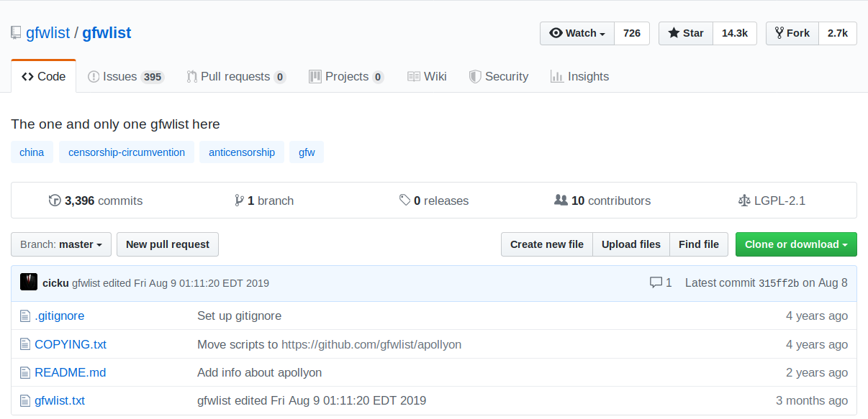
Protip: only tunnel blocked traffic

Slide 33
Alternative Protocols

Slide 34


Slide 35
Wireguard Configuration
k@X1 ~ $ cat /etc/wireguard/projectpull.conf
[Interface]
Address = 10.192.122.2/32
DNS = 10.192.122.1
PrivateKey = UUErDoqPKV5rL7eQlN+kREv2DxIoZF/Ku0zrO7BF838=
[Peer]
PublicKey = Z/yGpYybFwzDVXYz0E3GkGrnPCx8zQXcA4+JQ3eK+3k=
AllowedIPs = 0.0.0.0/0,::/0
Endpoint = 35.230.46.110:51820

Slide 36
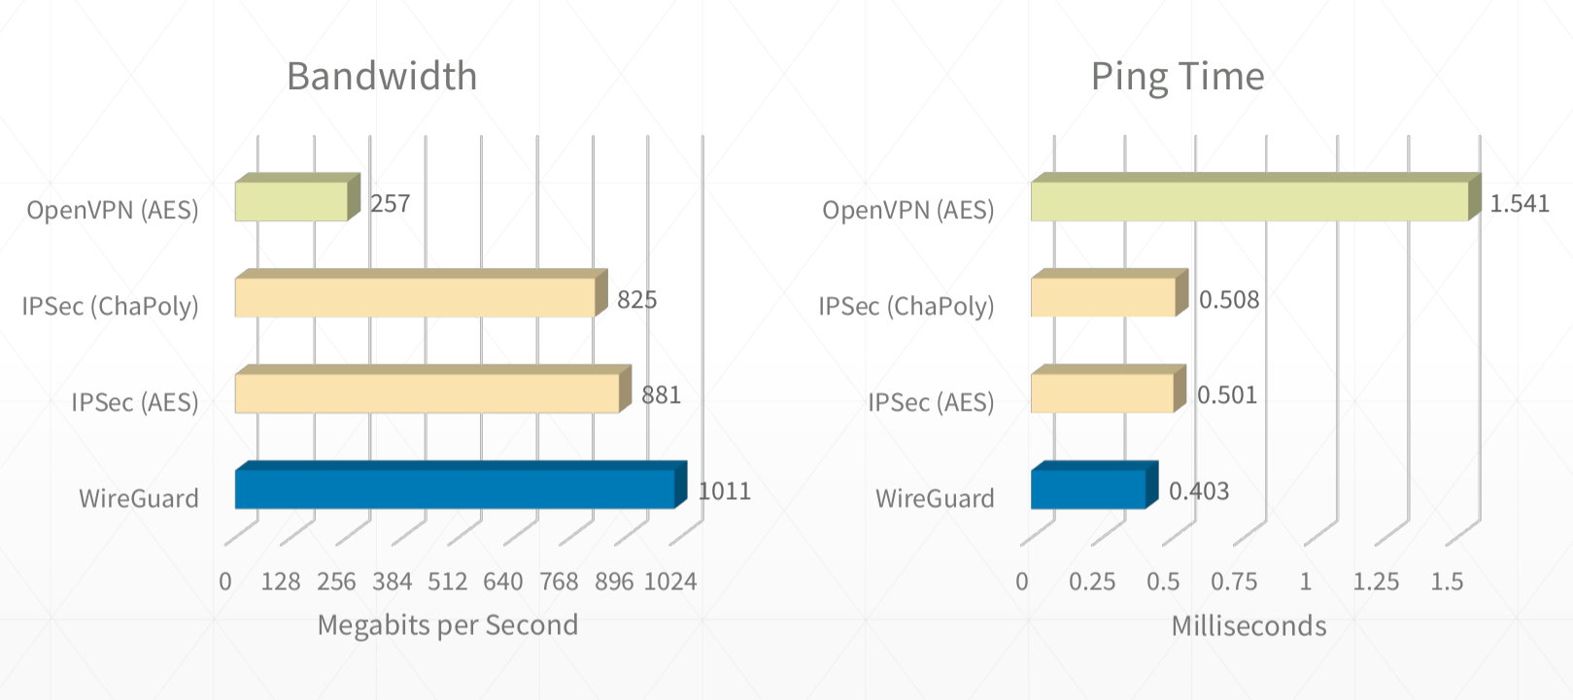
Wireguard Is Fast

Slide 37
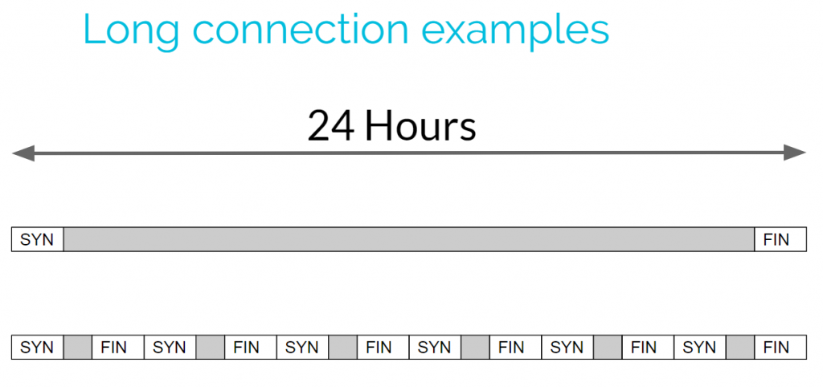
Wireguard Is Quiet

Slide 38
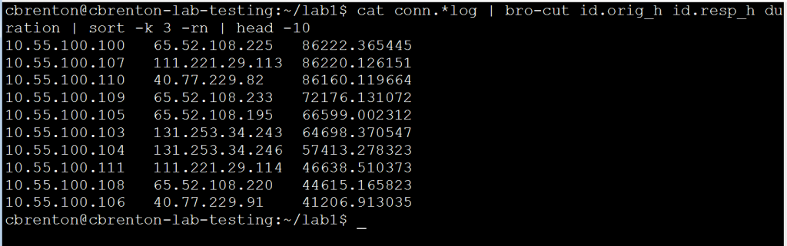
Finding The Longest Connections With Zeek

Slide 39

If You Can’t Beat Them, Join Them
OpenConnect is built on top of standards like HTTP, TLS, and DTLS, and it's one of the most popular and widely used VPN technologies.
Common to large multi-national corporations, it often means that at the protocol level, it is seldom blocked.
AnyConnect: UDP 443 || TCP 443
IKEv2: UDP 4500 && UDP 500
PPTP: TCP 1723

Slide 40
Use DNSCAT2 to tunnel traffic (server)
root@projectpull.org ~ $ ruby ./dnscat2.rb --dns “host=192.168.0.4”
New window created: 0
New window created: crypto-debug
Welcome to dnscat2! Some documentation may be out of date.
auto_attach => false
history_size (for new windows) => 1000
Security policy changed: All connections must be encrypted
New window created: dns1
Starting Dnscat2 DNS server on 10.168.0.4:53
To talk directly to the server without a domain name, run:
./dnscat --dns server=x.x.x.x,port=53 --secret=b042cb96c2717245f26c0b091b33e9af
command (X1) 2> ping
Ping!
command (X1) 2> Pong!
listen 2222 10.69.69.14:22
Listening on 0.0.0.0:2222, sending connections to 10.69.69.14:22
command (X1) 2> Connection from 127.0.0.1:38074; forwarding to 10.69.69.14:22...
[Tunnel 0] connection successful!

Slide 41
Use DNSCAT2 to tunnel traffic (client)
k@x1 ~ $ ./dnscat --dns server=35.236.29.41,port=53 --secret=7a5517be4d20e2c74e0e0ab597d90c02 Creating DNS driver:
domain = (null)
host = 0.0.0.0
port = 53
type = TXT,CNAME,MX
server = 35.236.29.41
** Peer verified with pre-shared secret!
Session established!
Got a command: COMMAND_PING [request] :: request_id: 0x0001 :: data: AEOTAMWYKBDSSESHJVPGEHQQKGZKIFYNRJXJQUAUXPOHZRGMANFDUBPADGNNKOGMGEVJUESHUWJHUEONYOHWVOYHZKQBWSV
[[ WARNING ]] :: Got a ping request! Responding!
Response: COMMAND_PING [response] :: request_id: 0x0001 :: data: AEOTAMWYKBDSSESHJVPGEHQQKGZKIFYNRJXJQUAUXPOHZRGMANFDUBPADGNNKOGMGEVJUESHUWJHUEONYOHWVOYHZKQBWSV
Got a command: TUNNEL_CONNECT [request] :: request_id 0x0002 :: host 10.69.69.14 :: port 22
[[ WARNING ]] :: [Tunnel 0] connecting to 10.69.69.14:22...
[[ WARNING ]] :: [Tunnel 0] connected to 10.69.69.14:22!

Slide 42
DNSCAT2 Tunneling
listen [lhost:]lport rhost:rport
listen 127.0.0.1:4444 google.com:80
k@x1 ~ $ curl -v --socks5 127.0.0.1:4444 google.com
* Rebuilt URL to: google.com/
* Trying 127.0.0.1...
* TCP_NODELAY set
* SOCKS5 communication to google.com:80
* SOCKS5 connect to IPv4 172.217.4.174 (locally resolved)
* SOCKS5 request granted.
* Connected to 127.0.0.1 (127.0.0.1) port 4444 (#0)
> HEAD / HTTP/1.1
> Host: google.com
> User-Agent: curl/7.58.0
> Accept: */*

Slide 43
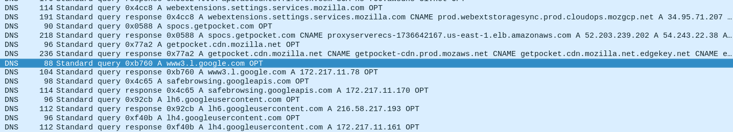
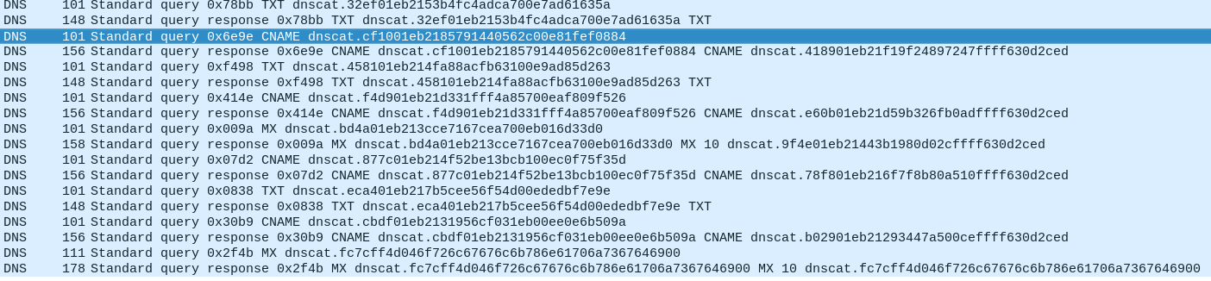
Normal DNS Traffic
DNSCAT2 Traffic

Slide 44
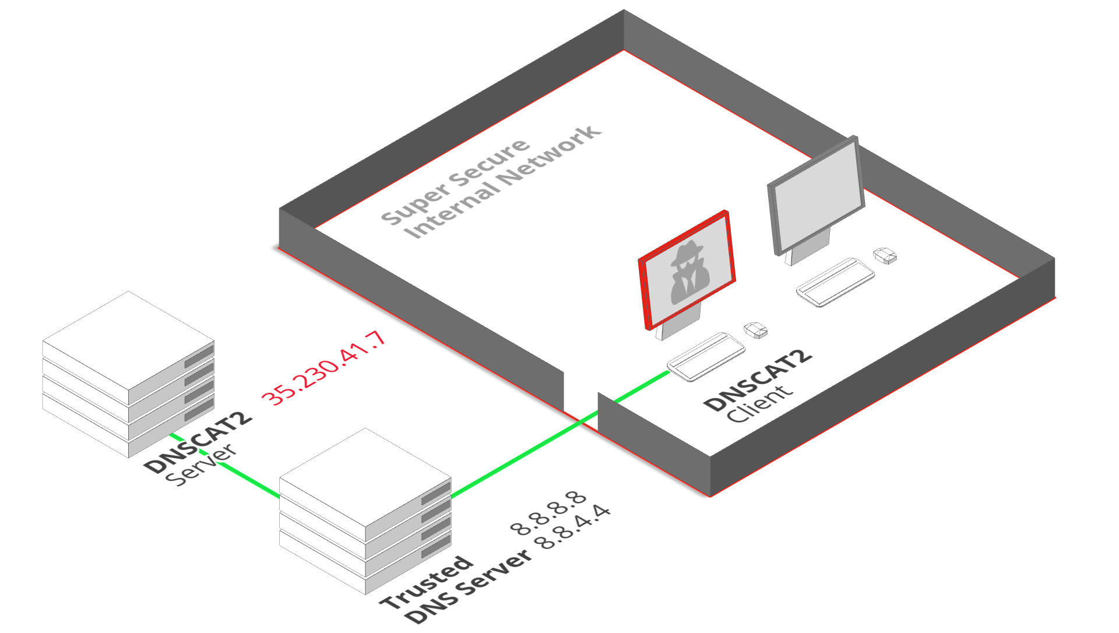
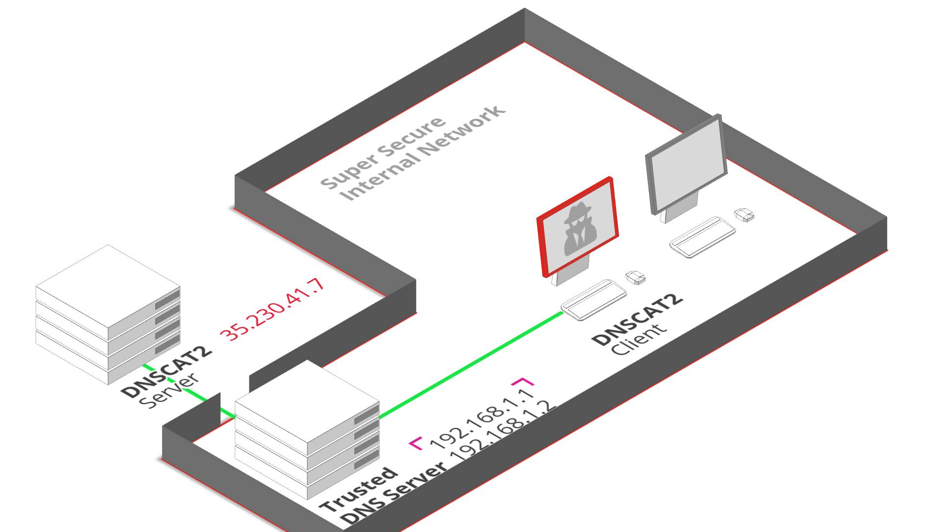
For Best Results, Setup Your Own Authoritative
DNS
Servers

Slide 45
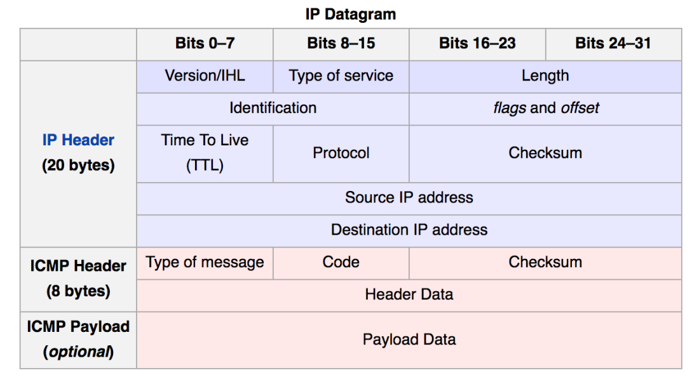
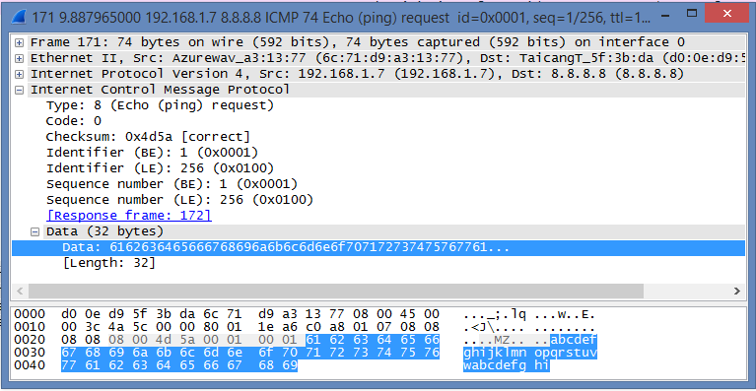
Use The Power of Ping

Slide 46
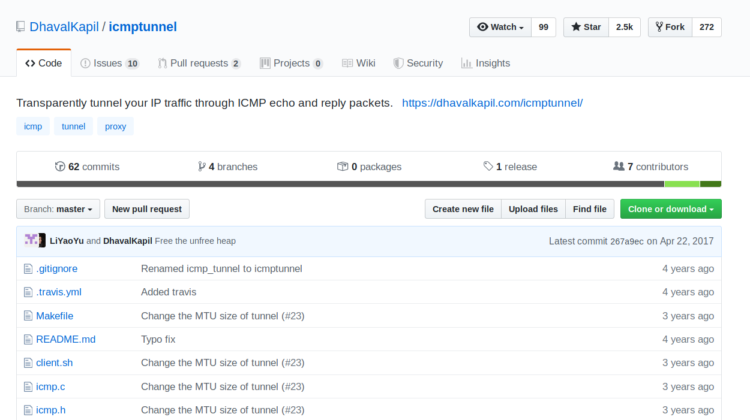

Slide 47
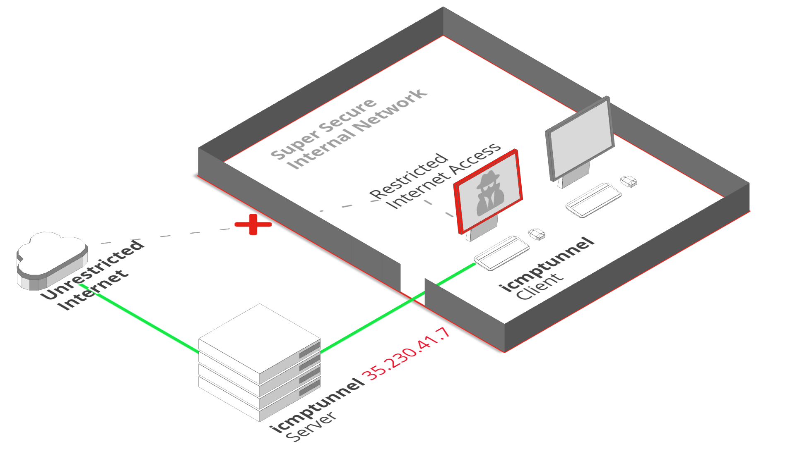
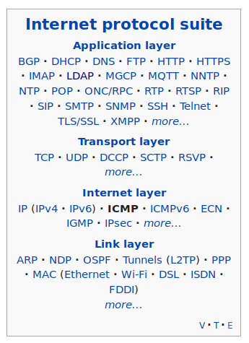

Slide 48
icmptunnel (server)
root@projectpull.org ~ $ ./icmptunnel –s
opened tunnel device: tun0
(ctrl-z)
# bg
# /sbin/ifconfig tun0 10.0.0.1 netmask 255.255.255.0
icmptunnel (client)
k@X1 ~ $ ./icmptunnel projectpull.org
opened tunnel device: tun0
connection established.
(ctrl-z)
# bg
# /sbin/ifconfig tun0 10.0.0.2 netmask 255.255.255.0
k@X1 ~ $ ssh -v -D 8080 root@10.0.0.1
OpenSSH_7.6p1 Ubuntu-4ubuntu0.3, OpenSSL 1.0.2n 7 Dec 2017
debug1: Connecting to projectpull.org [35.235.29.49] port 22.
debug1: Connection established

Slide 49
DPI Evasion

Slide 50
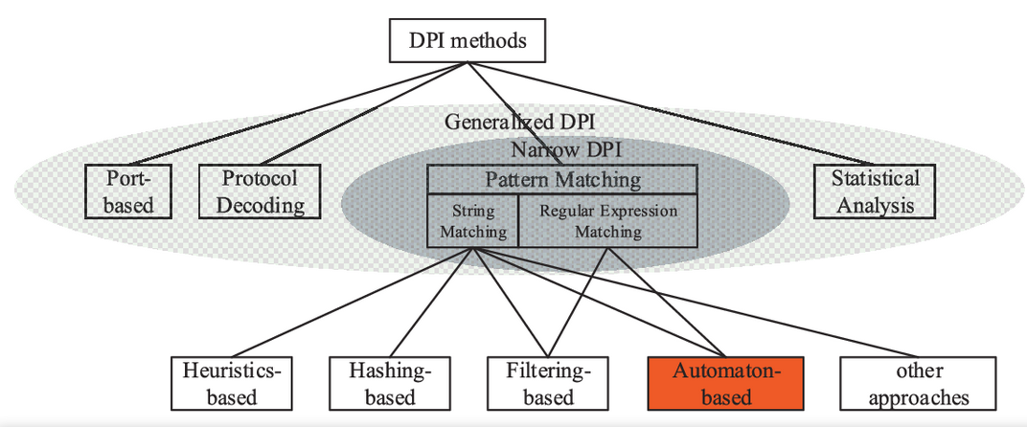

Slide 51
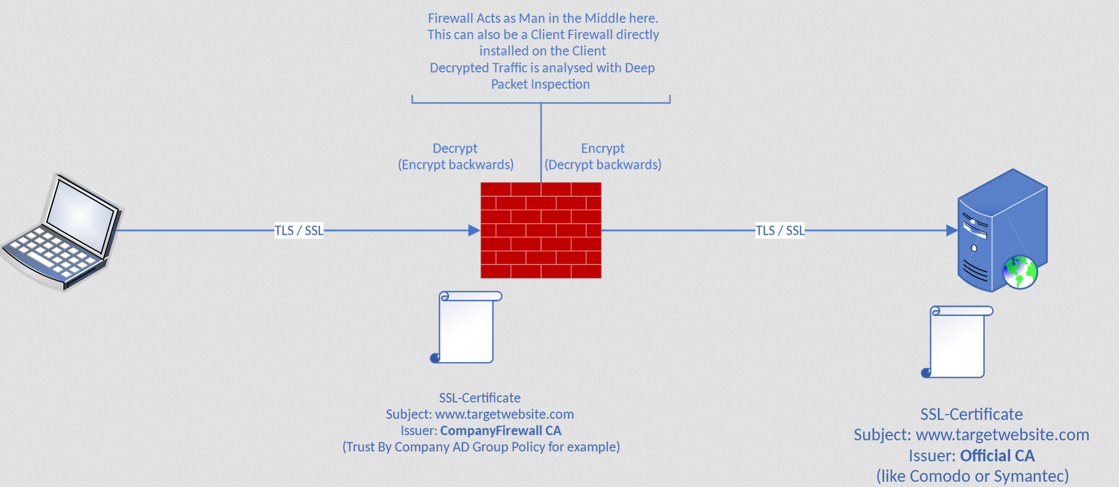
Deep Packet Inspection With SSL Inspection

Slide 52
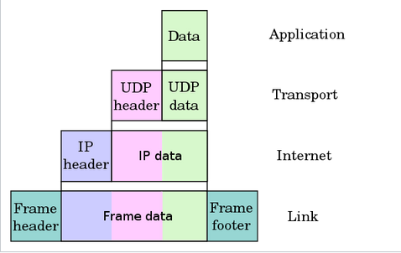
DPI Detection Methods
Pattern or Signature Matching
Regex on headers
Regex on data protocol structures
80 46 01 03 01 00 2d 00 00 00 10 00 00 05 00 00 04 00 00 0a 00 00 09 00 00 64 00 00 62 00 00 08 00 00 03 00 00 06 01 00 80 07 00 c0 03 00 80 06 00 40 02 00 80 04 00 80

Slide 53
Bypassing
String / Regex Matching
GET / HTTP/1.1
hoSt:wWw.fAcE
bOoK.cOm.
usEr-AgEnt:cuRl/7.58.0
AccEpt: */*
GET / HTTP/1.1
Host: www.facebook.com
User-Agent: curl/7.58.0
Accept: */*
TCP Packet
Fragmentation
Simple Obfuscation
https://noxxi.de/research/http-evader.html

Slide 54
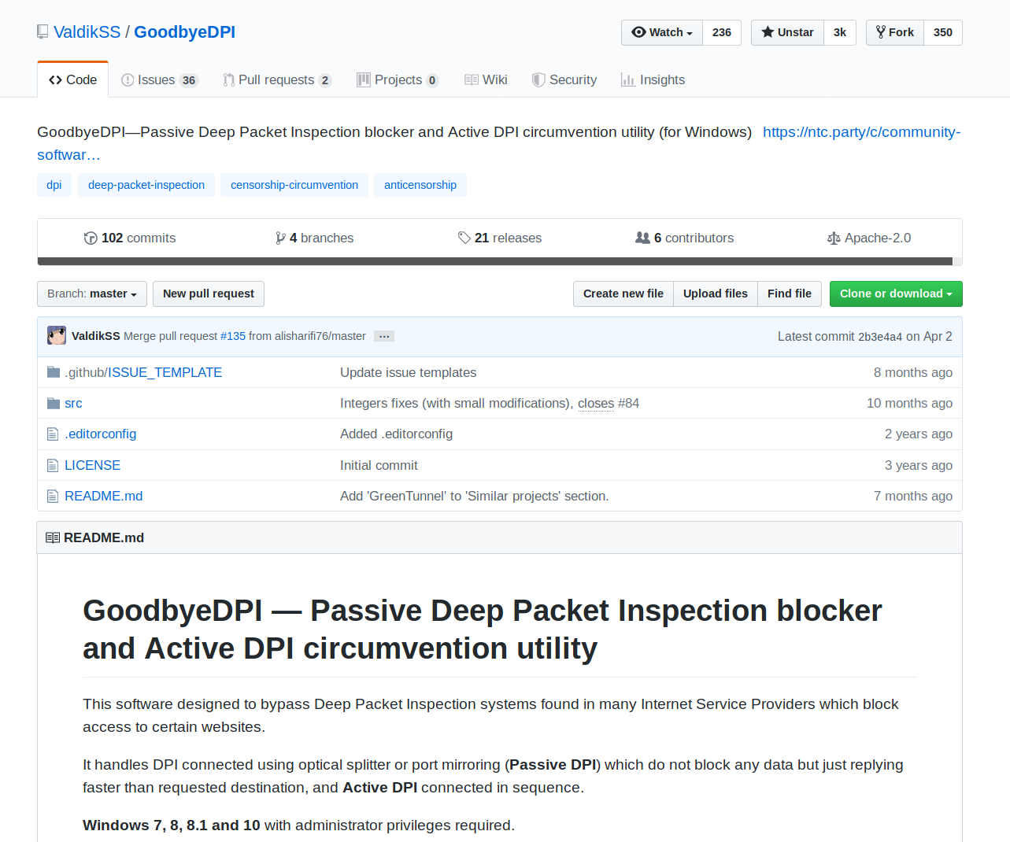
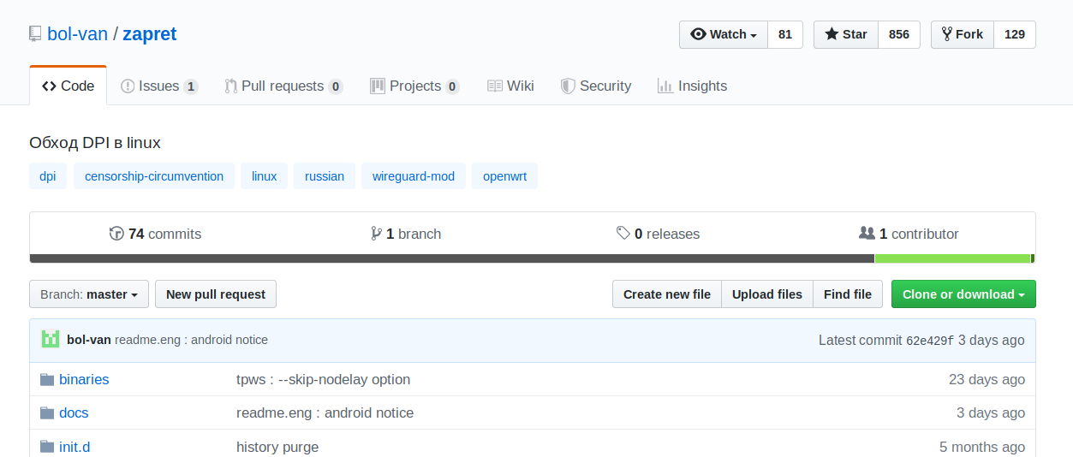

Slide 55

Confusing The Great Firewall
SYN
RST
seq=4
seq=89
seq=35
Your state is not mine: a closer look at evading stateful internet censorship
https://dl.acm.org/citation.cfm?doid=3131365.3131374
seq=749
seq=50
seq=838
seq=451

Slide 56
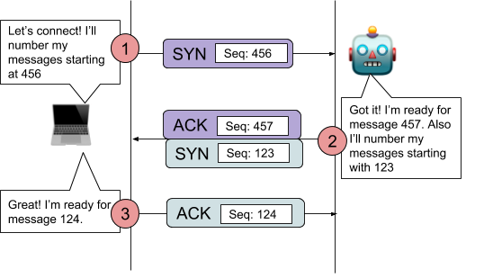
Desynchronizing the
TCP Control Block
Send SYN insertion packet with modified sequence number
Packet will have wrong checksum or low TTL and be rejected
Initiate the connection with the correct sequence number
Traffic is ignored due to unexpected sequence number
Send invalid RST, RST/ACK or FIN packets at the firewall
Packet will have wrong checksum or low TTL and be rejected

Slide 57
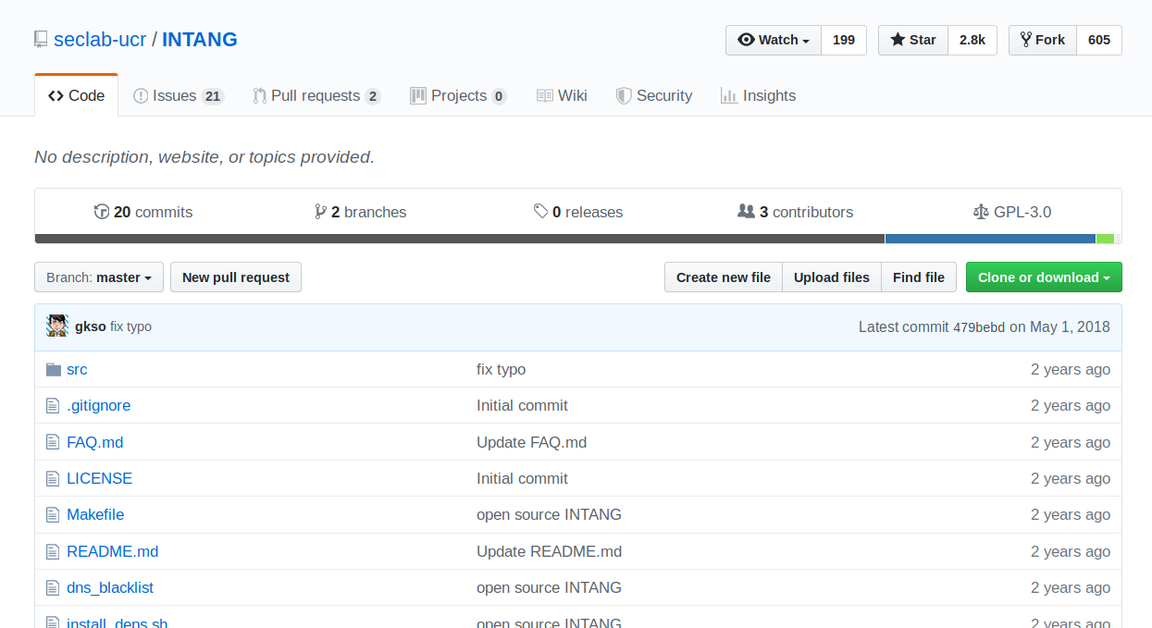
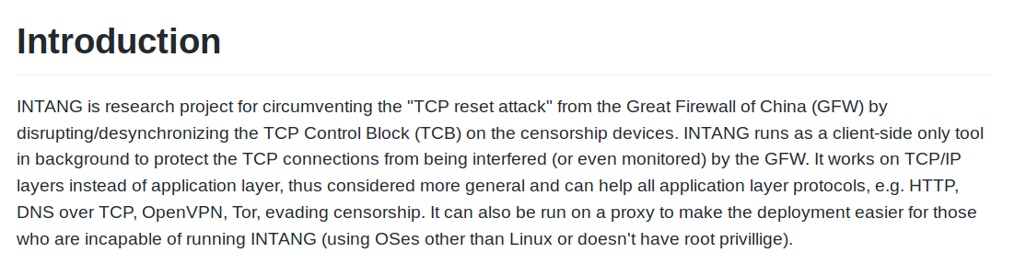

Slide 58
Ignoring RST
IP-Header - RFC 791
0 1 2 3
0 1 2 3 4 5 6 7 8 9 0 1 2 3 4 5 6 7 8 9 0 1 2 3 4 5 6 7 8 9 0 1
+-+-+-+-+-+-+-+-+-+-+-+-+-+-+-+-+-+-+-+-+-+-+-+-+-+-+-+-+-+-+-+-+
|Version| IHL |Type of Service| Total Length |
+-+-+-+-+-+-+-+-+-+-+-+-+-+-+-+-+-+-+-+-+-+-+-+-+-+-+-+-+-+-+-+-+
| Identification |Flags| Fragment Offset |
+-+-+-+-+-+-+-+-+-+-+-+-+-+-+-+-+-+-+-+-+-+-+-+-+-+-+-+-+-+-+-+-+
| Time to Live | Protocol | Header Checksum |
+-+-+-+-+-+-+-+-+-+-+-+-+-+-+-+-+-+-+-+-+-+-+-+-+-+-+-+-+-+-+-+-+
| Source Address |
+-+-+-+-+-+-+-+-+-+-+-+-+-+-+-+-+-+-+-+-+-+-+-+-+-+-+-+-+-+-+-+-+
| Destination Address |
+-+-+-+-+-+-+-+-+-+-+-+-+-+-+-+-+-+-+-+-+-+-+-+-+-+-+-+-+-+-+-+-+
| Options | Padding |
+-+-+-+-+-+-+-+-+-+-+-+-+-+-+-+-+-+-+-+-+-+-+-+-+-+-+-+-+-+-+-+-+
0x0000
0x0001
Identification Field: A value assigned by the sender to aid in assembling the fragments of a datagram.

Slide 59

I’d Tell You A Joke About UDP
But I’m not sure you’d get it.

Slide 60
Wireguard (UDP) -> UDPTUNNEL (TCP)
root@projectpull.org ~ $ udptunnel -s 443 127.0.0.1/51820
k@X1 ~ $ udptunnel -c 35.230.46.110/443 127.0.0.1 51818
k@X1 ~ $ cat /etc/wireguard/projectpull.conf
[Interface]
Address = 10.192.122.2/32
DNS = 10.192.122.1
PrivateKey = UUErDoqPKV5rL7eQlN+kREv2DxIoZF/Ku0zrO7BF838=
[Peer]
PublicKey = Z/yGpYybFwzDVXYz0E3GkGrnPCx8zQXcA4+JQ3eK+3k=
AllowedIPs = 0.0.0.0/0,::/0
Endpoint = 127.0.0.1:51820

Slide 61



DNS Over HTTPS

Slide 62

k@X1 ~ $ curl -s -H 'accept: application/dns-json' \
'https://cloudflare-dns.com/dns-query?name=facebook.com&type=A' | jq
{
"Status": 0,
"TC": false,
"RD": true,
"RA": true,
"AD": false,
"CD": false,
"Question": [
{
"name": "facebook.com.",
"type": 1
}
],
"Answer": [
{
"name": "facebook.com.",
"type": 1,
"TTL": 77,
"data": "31.13.70.36"
}
]

Slide 63

SNI
The TLS Server Name Indication (SNI) extension, originally standardized back in 2003, lets servers host multiple TLS-enabled websites on the same set of IP addresses, by requiring clients to specify which site they want to connect to during the initial TLS handshake.

Slide 64

ESNI
The TLS Encrypted Server Name Indication (ESNI) extension, is currently an experimental protocol proposed on July 08, 2019.
Public key is published on a DNS Record
Server holds private key
Client sends SNI encrypted with public key

Slide 65


Slide 66


Plaintext SNI
Encrypted SNI

Slide 67
Content Blocking Blocking Methods
Send RST Packet (TCP reset attack)
iptables-A INPUT -p tcp --tcp-flags RST RST -j DROP
Poison DNS (redirect elsewhere)
Mitigate with ESNI + DNS Over HTTPS
Drop Packet Completely
Try to avoid detection with other techniques

Slide 68
Obfuscate Traffic
obfsproxy, ShadowVPN, SoftEther, goho, shadowsocks, SIP003, stunnel, V2Ray
{browser}
<--(socks)-->
{V2Ray client inbound <-> V2Ray client outbound}
<--(VMess)-->
{V2Ray server inbound <-> V2Ray server outbound}
<--(freedom)-->
{Target site}

Slide 69

VMESS
Protocol

Slide 70
Domain Fronting

Slide 71


Slide 72
k@X1 ~ $ curl -v -H "Host: projectpull.org" https://bing.com
* Rebuilt URL to: https://bing.com/
* Trying 13.107.21.200...
* TCP_NODELAY set
* Connected to bing.com (13.107.21.200) port 443 (#0)
-<SNIP>-
* SSL connection using TLSv1.2 / ECDHE-RSA-AES128-GCM-SHA256
* ALPN, server accepted to use h2
* Server certificate:
* subject: CN=www.bing.com
* start date: Jul 20 17:47:08 2017 GMT
* expire date: Jul 10 17:47:08 2019 GMT
* subjectAltName: host "bing.com" matched cert's "bing.com"
* issuer: C=US; ST=Washington; L=Redmond; O=Microsoft Corporation;
-<SNIP>-
> GET / HTTP/2
> Host: projectpull.org
> User-Agent: curl/7.58.0
> Accept: */*
-<SNIP>-
* Connection #0 to host bing.com left intact
<h2>Our services aren't available right now</h2><p>We're working to restore all services as soon as possible. Please check back soon.</p>0OPdbXAAAAACPvltTXmg8T6Ynwb1og0T8TE9OMDRFREdFMDQyMABFZGdl

Slide 73



Slide 74



Slide 75
More Resources on Domain Fronting
https://digi.ninja/blog/domain_fronting.php
https://vincentyiu.com/red-team/domain-fronting/domain-fronting-who-am-i
https://www.peew.pw/blog/2018/2/22/how-i-identified-93k-domain-frontable-cloudfront-domains

Slide 76
kevin@deoxy.net

